Slide 1

PES Institute of Technology and Management
Department of Computer Science & Engineering
A PRESENTATION ON,
“HOME AUTOMATION USING ARDUINO”
Presented by
Ms. APOORVA P 4PM11CS012
Ms. ARSHIYA TABASSUM 4PM12CS012
Ms. B.Y SIRI 4PM12CS018
Mr. MOHAMMED SALMAN 4PM12CS045
Under the Guidance of
Coordinators
Mr. CHETAN L.S, _{B.E., M.Tech, (PhD).}
Assistant Professor ,Dept of CSE
Mrs. PRATHIBA S
Mrs. NAYANA K

Slide 2
contents
Abstract
Home automation
Application
Requirements
Hardware specifications
Working
Result
Conclusion

Slide 3
abstract
The latest trend in the technologies related to wireless communication has led to the emergence of several engineering designs for human requirements. The creeping interests in the wireless and GSM based projects, we came up with this idea of developing a simpler, cost-effective design to control the on-off home lights via short message service (SMS) and PIR sensor.

Slide 4
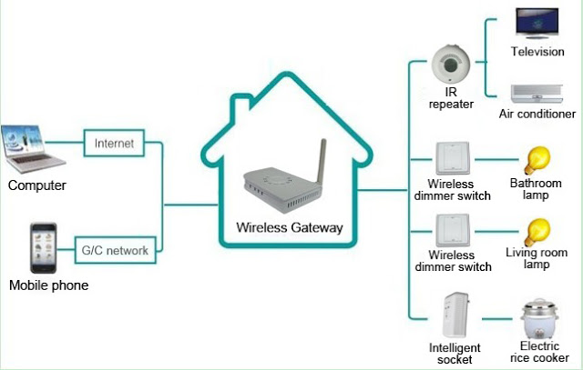
Home automation
Gsm controlled home lightening system
Home automation system integrates electrical devices in a house with each other.
The techniques includes control of domestic activities such as home entertainment systems, lighting control system and use of domestic robots.

Slide 5
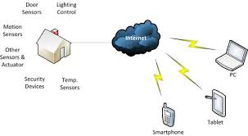
Home automation
A Lighting control system can be used to switch lights based on a time cycle.
Some electronically controlled lamps can be controlled for brightness or color to provide different light levels for different tasks.
Natural lighting (day-lighting) can be used to automatically control window shades and draperies.

Slide 6
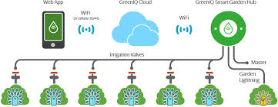
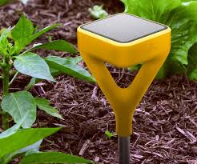
Smart Garden
A smart garden automation system integrates electrical devices in a garden such as irrigation valves, garden lighting with each other.
The techniques include control of irrigation activities such as automated water supply for plants and also lighting control system.

Slide 7
Hardware requirements
Arduino UNO Board.
GSM Module .
Relay(8-Switch).
PIR Sensor.
Jumping cables.

Slide 8
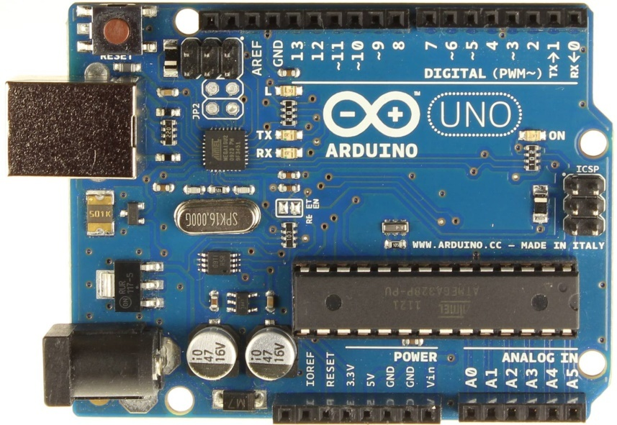
Arduino UNO Board
Microcontroller board based on the ATmega328P.
14 digital input/output pins (of which 6 can be used as PWM outputs), 6 analog inputs, a 16 MHz quartz crystal, a USB connection, a power jack, an ICSP header and a reset button.
It is connected to a computer with a USB cable or power it with a AC-to-DC adapter or battery to get started.

Slide 9
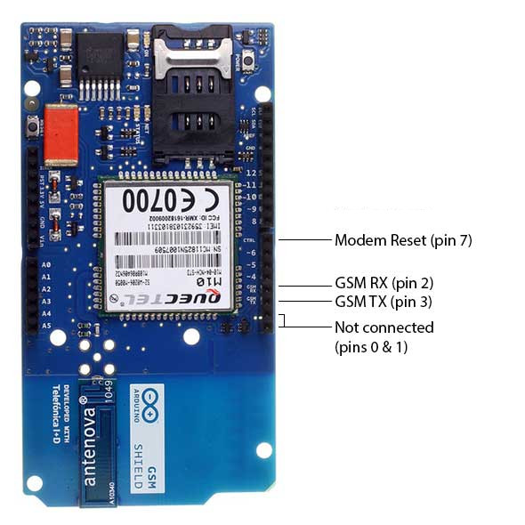
GSM Module
Operating voltage 5V (supplied from the Arduino Board).
Connection with Arduino Uno on pins 2, 3 (Software Serial) and 7 (reset).
The Arduino GSM Shield allows an Arduino board to connect to the Network, make/receive voice calls and send/receive SMS messages .

Slide 10
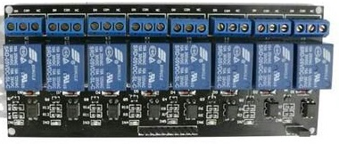
RELAY
RELAYS are the switches that open and close circuits electromechanically or electronically.
Main advantage is that it can control the large voltage.
Relay gets input from Arduino and switches the devices which is to be controlled.

Slide 11
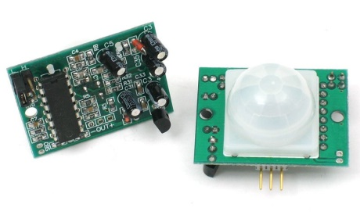
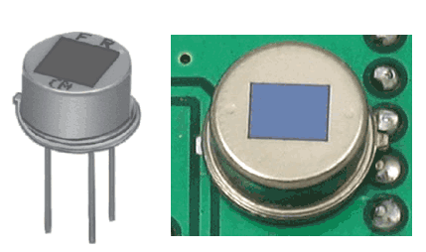
P I R sensors
Used here to detect the Human body movement, whenever there is any body movement the voltage at output pin changes.
Basically it detects the Change in Heat, and produce output whenever such detection occurs.
PIR slots consist of sensitive IR

Slide 12
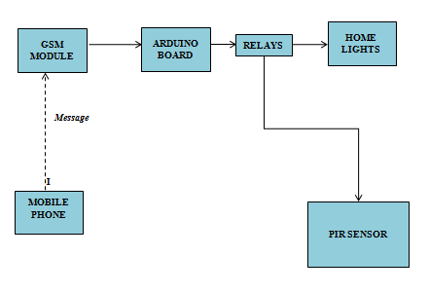
SYSTEM DESIGN

Slide 13
SYSTEM DESIGN
System consists of a Arduino mega board which acts as base for all connections .
It consists of a GSM module in which SIM card is inserted to receive SMS and communicate the received message with other devices like relay. And relays are used to switch the lights on/off.
It consists of PIR Sensor which detects human movements and switches the relay.

Slide 14
Arduino-relay integration

Slide 15
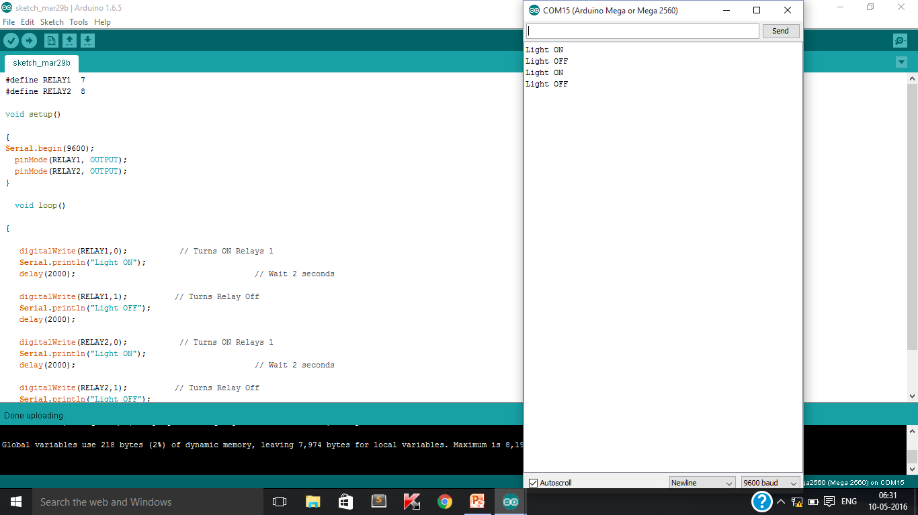

Slide 16
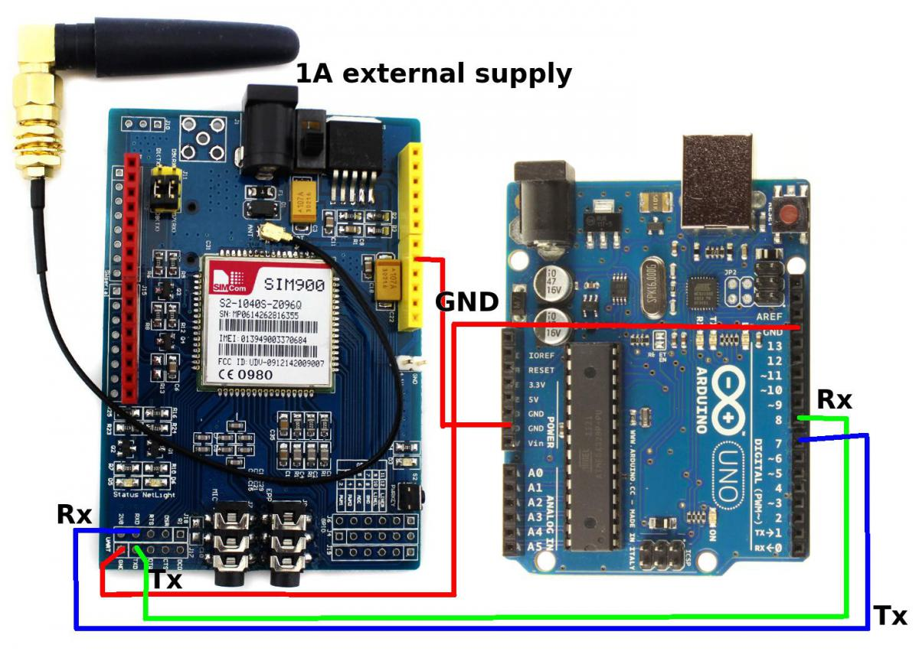
Arduino-GSM integration

Slide 17
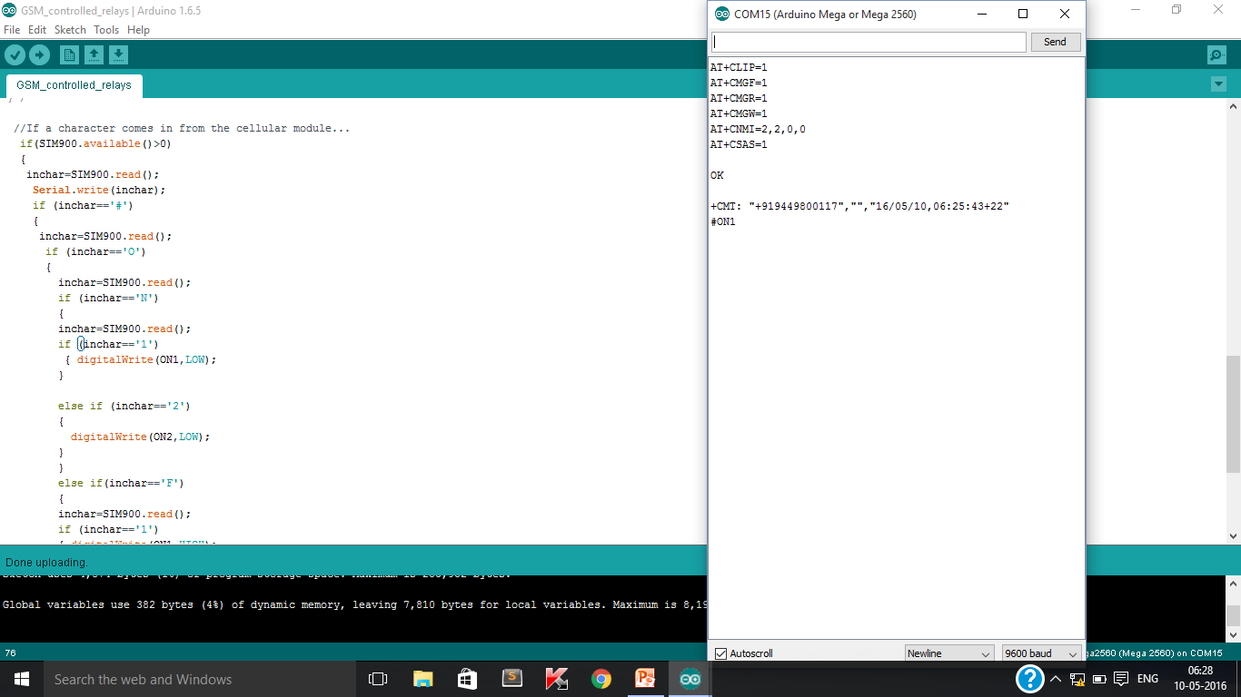
RESULT

Slide 18
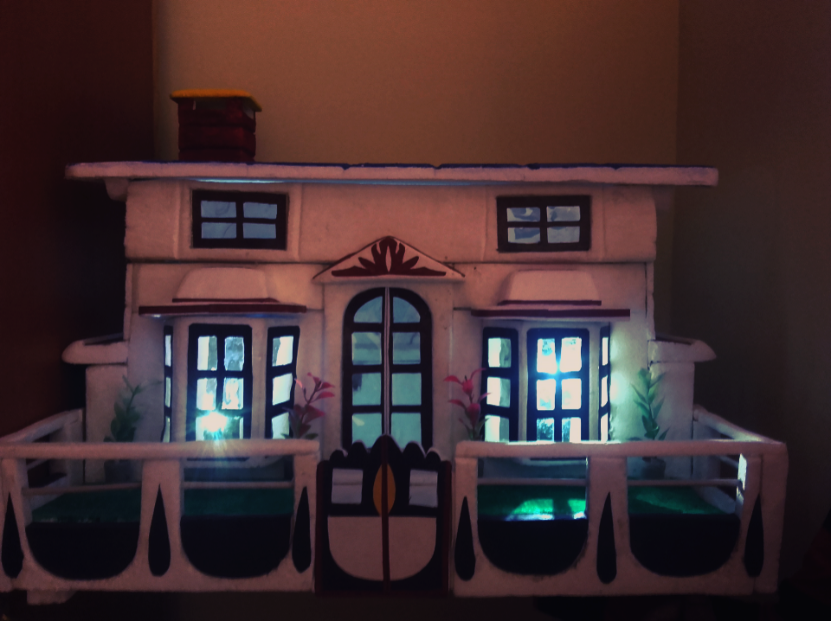
Home automation screenshot

Slide 19
Conclusion
The home automation using internet of things has been experimentally proven to work satisfactorily by connecting simple appliances to it and the appliances were successfully controlled remotely through network. This will help the user to switch on and switch off the home appliances anytime from anywhere using remote device.

Slide 20
FUTURE SCOPE
Home automation is automation of the home or household activity. Home activity may include centralized control of lighting, appliances and security locks of the gates to provide improved convenience, comfort, energy efficiency and security. Home automation system integrates electrical devices in a house with each other. By implementing Rfid tag reader with this system we can provide security for home or hospitals …

Slide 21
THANK YOU ☺

